Slide 1
Atomic Structure

Slide 2
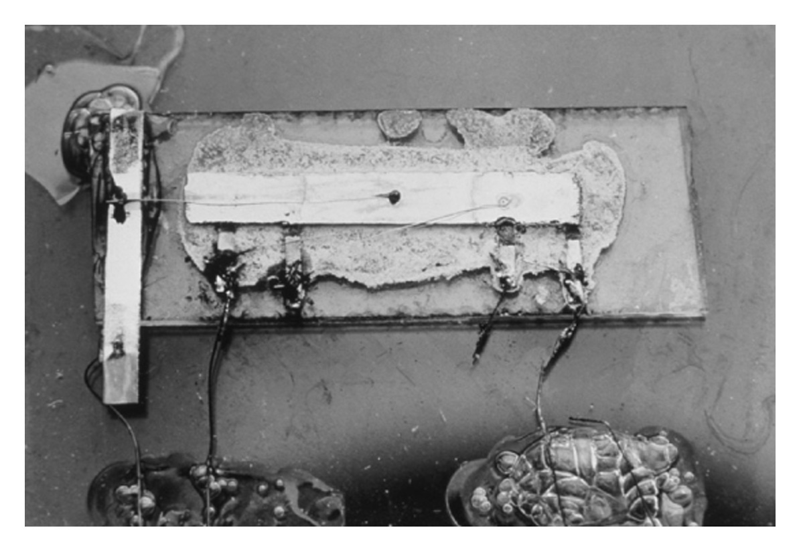
Fig. 1.1 The first integrated circuit, a phase-shift oscillator, invented by Jack S. Kilby in 1958. (Courtesy of Texas Instruments.)

Slide 3
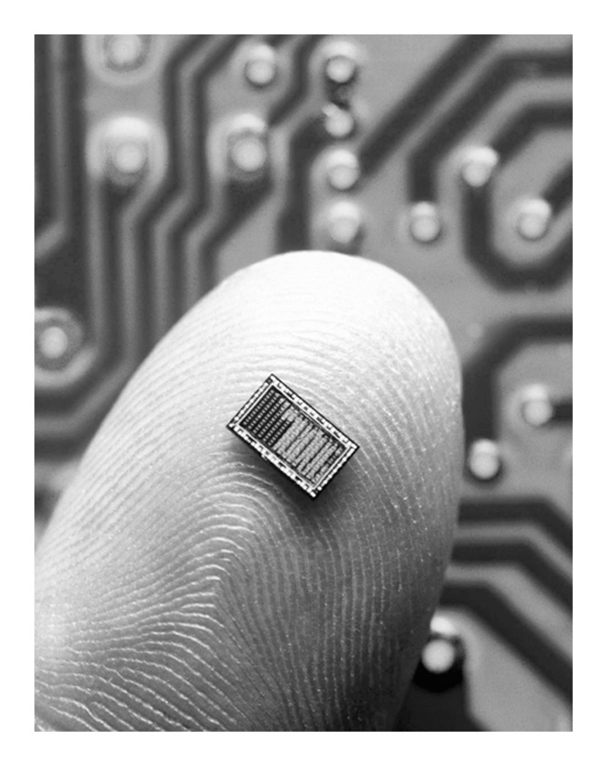
Fig. 1.2 Computer chip. (© Stock Photo/ CORBIS.)

Slide 4
ATOM
The smallest particle of an element that posses the unique characteristics of that element.
Diameter = 10⁻¹⁰ m
Electrically neutral

Slide 5
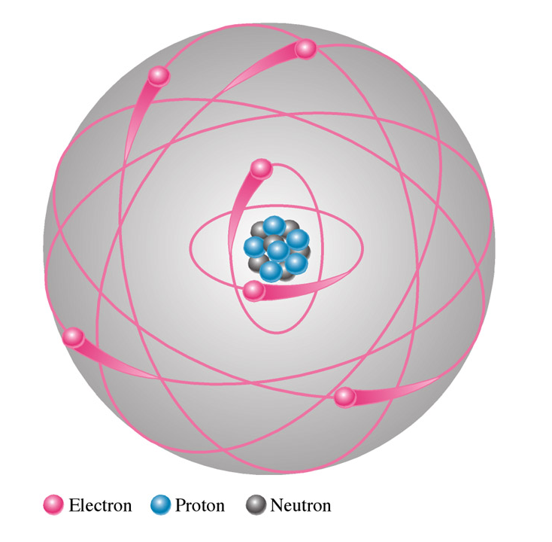
Bohr Model
Planetary type of structure that consists of a central nucleus surrounded by orbiting electrons
Nucleus contains all the protons and neutrons of the atom

Slide 6
Subatomic Particles
Mass: 1.6749543x10⁻²⁴ g
Zero electrical charge
Mass: 1.6726485x10⁻²⁴ g
Electrical charge of +1.60219x10⁻¹⁹ C
Mass: 9.109534x10⁻²⁸ g
Electrical charge of -1.60219x10⁻¹⁹ C
Neutron
Proton
Electron

Slide 7
Physical Properties
All atoms of an element have the same number of protons and electrons but they can have different number of neutrons in the nucleus.
Each type of atom has a certain number of electrons and protons which distinguish it from atoms of other elements.

Slide 8
Bohr Model

Slide 9
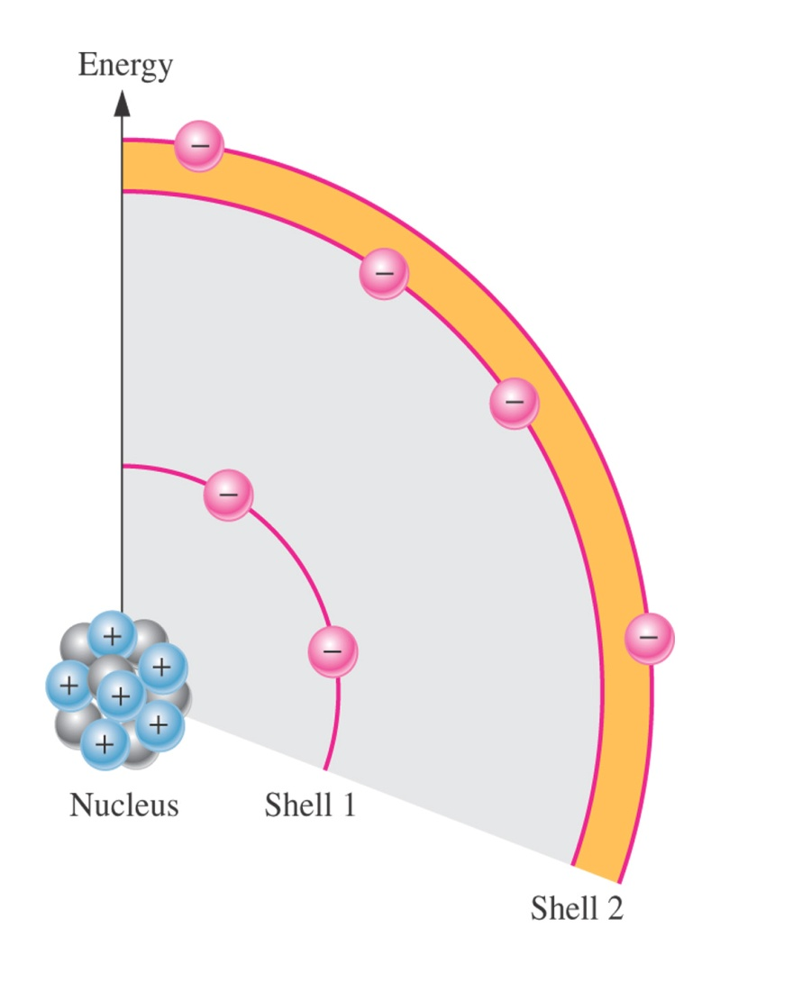
Shell
Layers (energy bands) in which electrons revolve around (orbit) the nucleus of an atom

Slide 10
The sequence of electron arrangement in an atom
n
Sub shell
Shell
s p d f
# of maximum electrons
1
2
3
4
5
6
7
K
L
M
N
O
P
Q
1s
2s 2p
3s 3p 3d
4s 4p 4d 4f
5s 5p 5d 5f
6s 6p 6d
7s 7p
2
8
18
32
32
18
8

Slide 11
Valence Shell
The outermost shell of an atom
Determines chemical characteristics of an element

Slide 12
Valence Electrons
Electrons that orbit in the outermost shell
Determine material’s electrical properties

Slide 13
Free Electron
An electron that has acquired enough energy from an outside source to break away from the valence band of the parent atom

Slide 14
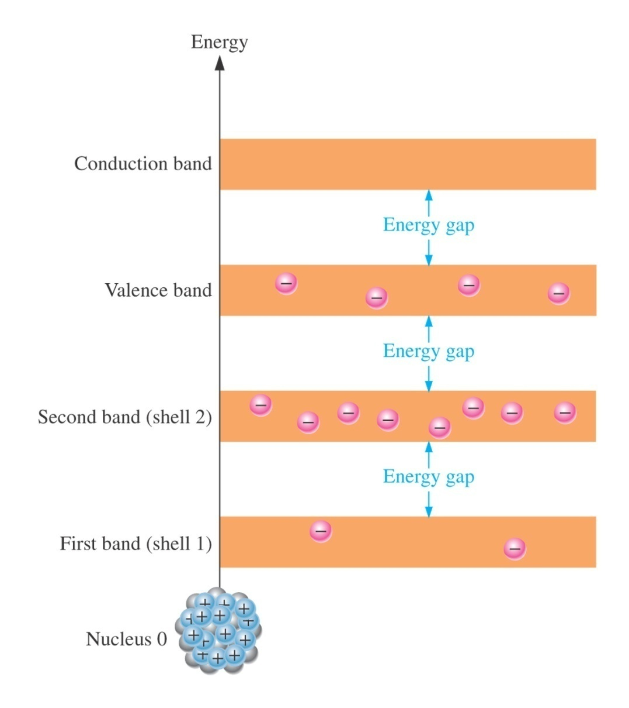
Energy Band

Slide 15
Energy Band
Metallic Conductor
Semi Conductor
Insulator
Empty
bands
conduction band
small
band
gap
Large
Band
Gap
no
band
gap
valence band
filled
bands

Slide 16
Ionization
The process of removal or addition of an electron from or to a neutral atom so that the resulting atom has a net positive or negative charge

Slide 17
Excess Charge
Cation (+ ion)
More protons than electrons
Anion (- ion)
More electrons than protons

Slide 18
Ion
An atom that has lost or gained electrons, making it a negative or positive charge

Slide 19
Energy Levels
Represent distance from the nucleus and the amount of energy possessed by an electron

Slide 20
Stable Orbits
Electrons are not pulled into the nucleus when the centrifugal force created by electrons’ circular motion (kinetic energy) is exactly equal to the electrostatic force (inward pull) of the nucleus

Slide 21
Conductor
A material that allows electrical current to flow through it easily
has valence shell less than half-filled

Slide 22
Insulator
A material that offers high resistance to electrical current flow
has valence shell more than half-filled

Slide 23
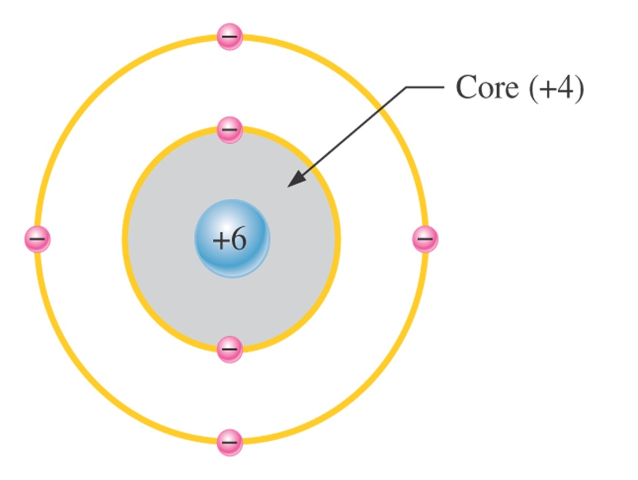
Semiconductor
A material that has a value of electrical resistance between that of a conductor and an insulator
has 4 electrons in its valence shell

Slide 24
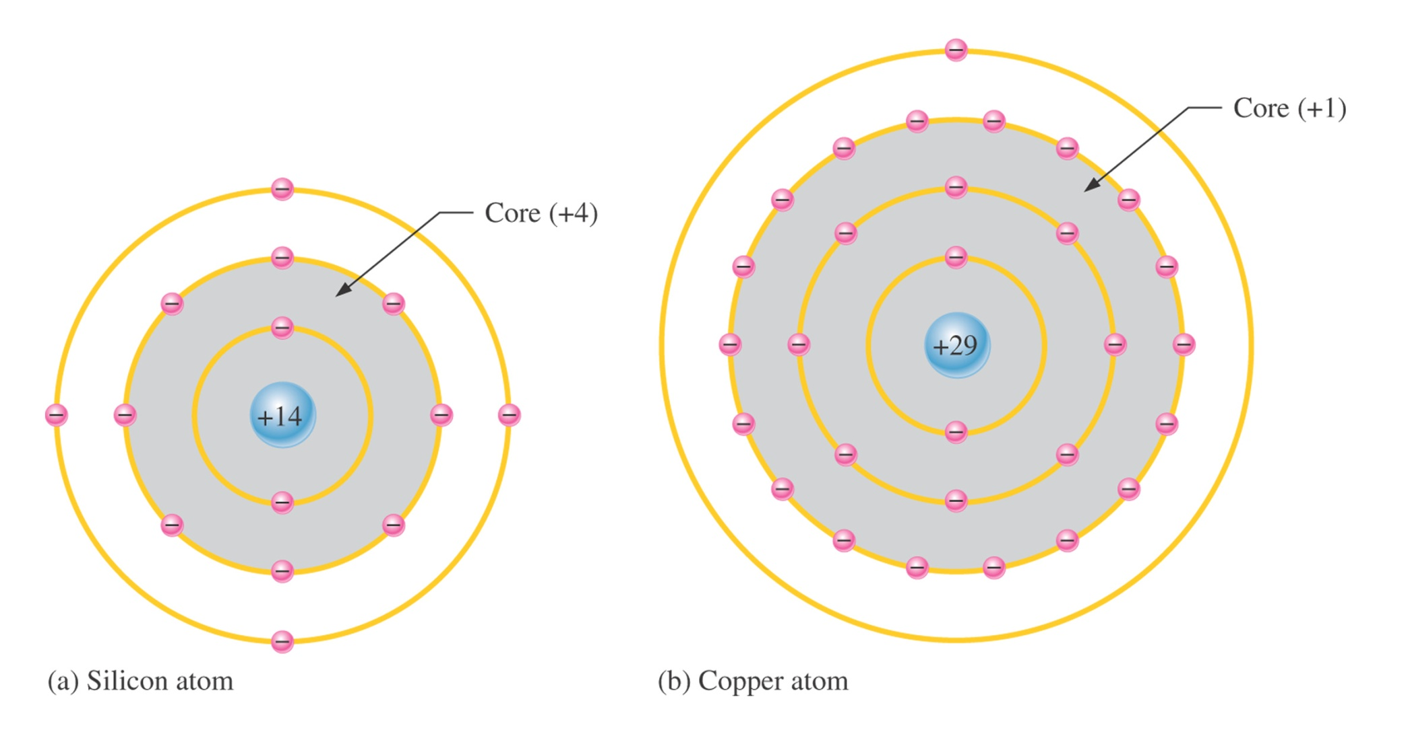

Slide 25
Valence Band
The highest energy level that the valence electrons can attain and still be influenced by the nucleus

Slide 26
Conduction Band
The outermost energy level of an atom

Slide 27
Forbidden Gap
Forbidden band of energy levels in which no electrons are found

Slide 28
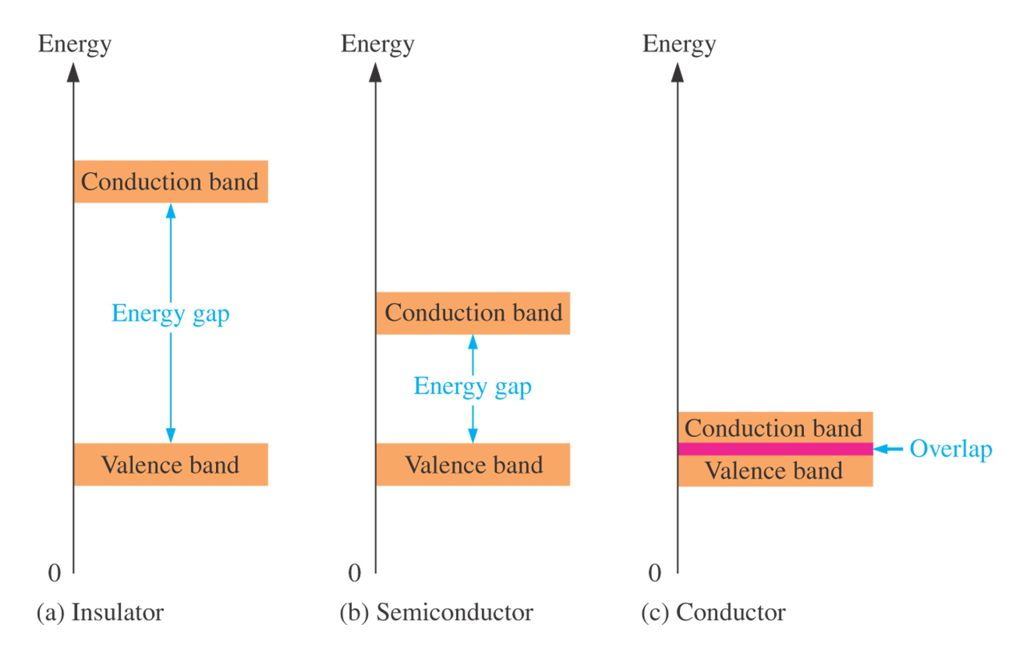

Slide 29
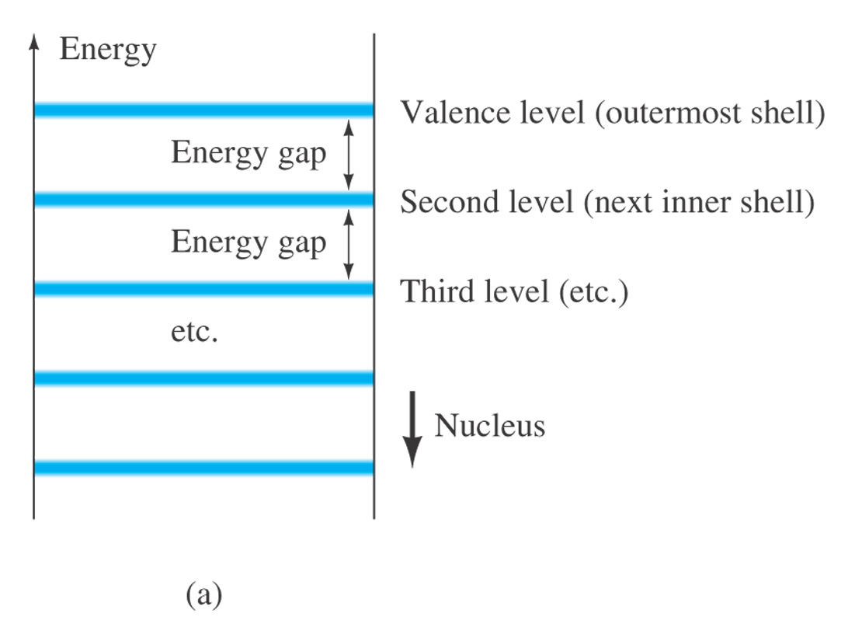
Fig. 1.6 Energy levels: (a) discrete levels in isolated atomic structures; (b) conduction and valence bands of an insulator, a semiconductor, and a conductor.

Slide 30
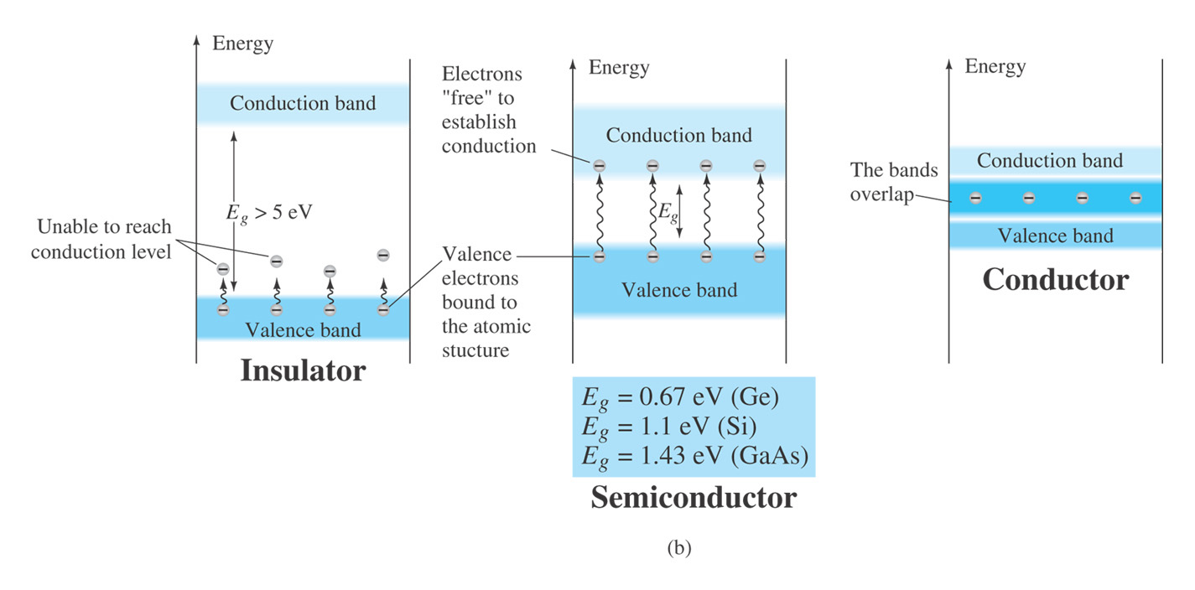
Fig. 1.6 (continued) Energy levels: (a) discrete levels in isolated atomic structures; (b) conduction and valence bands of an insulator, a semiconductor, and a conductor.

Slide 31
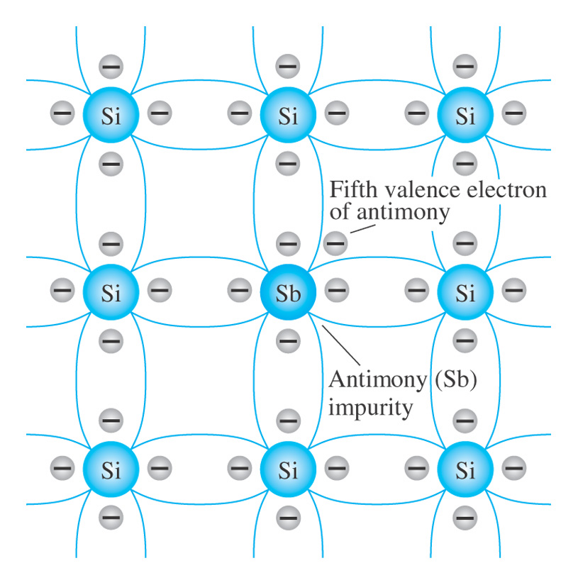
Fig. 1.7 Antimony impurity in n-type material.

Slide 32
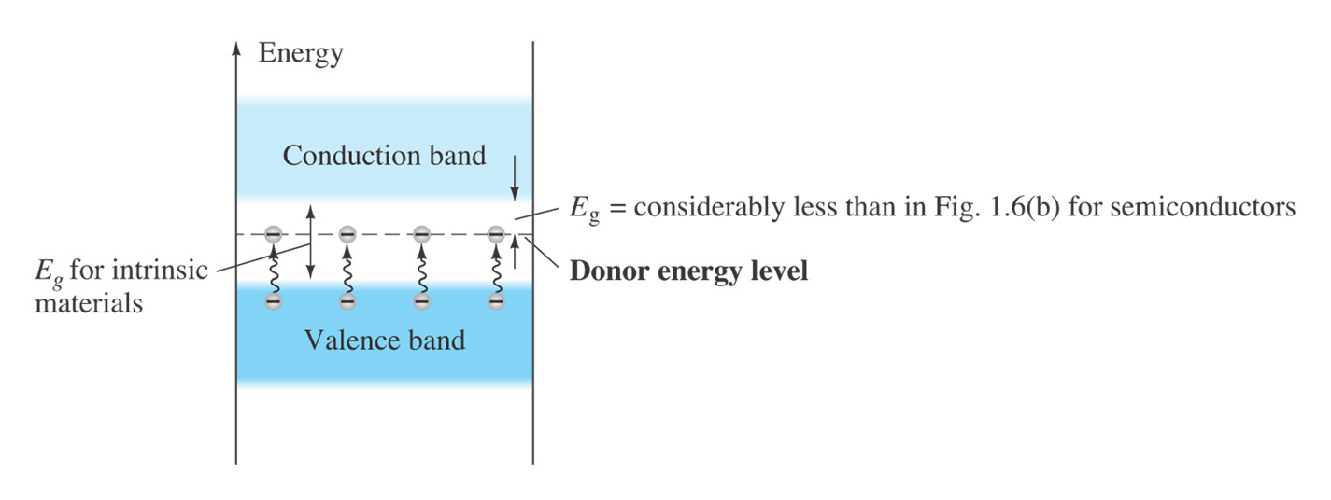
Fig. 1.8 Effect of donor impurities on the energy band structure.

